Slide 1

Sinhgad College of Engineering, Pune – 41. Department of Electronics &Telecommunication Engineering
Life Health Band – Health Monitoring System For Elderly People.
Group No- 31
By-
1. Piyusha Prakash Patil . (404B045)
2. Ishwarya Rajendra Kamble. (404B015)
3. Atish Gajanan Pawar. (404B049)
Under the Guidance - Prof (Mrs.) V .G. Raut Mam
Thursday
December 03,2020

Slide 2
OBJECTIVE
AIM: To design and develop a IOT based system collects the data where it is processed and analyzed for improved elderly lifestyle.
Objectives:
To develop a ARM based Embedded Board from scratch.
To design and develop to sense various body parameters for elderly.
To develop a Graphical user interface (GUI) on IOT so that the doctor can process and analyze the active lifestyle.
To develop a report excel sheet to analyse the active lifestyle pattern of elderly.
Thursday
December 03,2020
Life Health Band – Health Monitoring System For Elderly People.

Slide 3
SPECIFICATIONS OF PROJECT
Arduino UNO- 8 bit ATmega328P (Freq-16MHZ)
Operating Voltage- 5volts
Pulse Sensor(SEN-11574) - 0.625" Diameter and 0.125" Thick
Accelerometer- ADXL335 Triple Axis , 6 pin Accelerometer
Temperature Sensor - LM35 - 3pin
Emergency button- 6x6x5mm Tactile Push Button
16x2 LCD Display
Wifi Module – ESP8266
Android/IOS Mobile
Power Bank/ 9V battery
Buzzer
Thursday
December 03,2020
Life Health Band – Health Monitoring System For Elderly People.

Slide 4
LITERATURE SURVEY
In Remote health monitoring system using is used to transmit the patients’ health parameters collected through microcontroller to the doctors and caretaker wirelessly.[1]
Being long range wireless technology, emergency situation of the patient’s health is quickly detected and timely intervention leads to save the life of the patient.[1]
Due to costlier healthcare and long waiting time in hospitals, the concept of in-home patient monitoring system have been emerging in the recent years.[2]
This system collects data of various body parameters through Biosensors, wearable devices and smart textiles and it transmits the data The server rings alarm to the ambulance during emergency situation. It is very beneficial for elders and chronic patients who require continuous monitoring.
This system performs basic health checkups by measuring the body parameters regularly and report the data to the doctors.[3]
Thursday
December 03,2020
Life Health Band – Health Monitoring System For Elderly People.

Slide 5
MOTIVATION –
Existing methods in patient monitoring system focuses on providing better healthcare facilities to a number of patients with limited medicinal resources.
These monitoring systems limit the patients to the bed and enable them to move around only a particular range from the bed side. Out of this range there is no possibility to collect the data from patients. The decisions or suggestions given by the system are not highly accurate.
The traditional forecasting techniques do not provide timely and accurate results. This increases the risk of error in providing appropriate clinical services.
Remote patient monitoring system eliminates the hurdles such as distance and improves the access of medical services.
Patient monitoring through android mobile phone enables the doctors to monitor the patient from multiple locations. Pattern Matching Algorithm is used to determine the type of diseases and give the indication to Doctor. It helps to protect the person from risk factor.
Thursday
December 03,2020
Life Health Band – Health Monitoring System For Elderly People.

Slide 6
BLOCK DIAGRAM
LCD
Temperature sensor
Arduino
UNO
Wi-Fi Module
Pulse Rate Sensor
Mobile
Accelerometer
Mobile 3
Mobile 1
Mobile 2
IoT Servers
Buzzer
Emergency Button
Power Bank
Thursday
December 03,2020
Life Health Band – Health Monitoring System For Elderly People.

Slide 7
HARDWARE AND SOFTWARE USED
Hardware:
Arduino
Temperature Sensor
Pulse Sensor
Accelerometer
Buzzer
Wi Fi Module
Emergency Button
Android Phone
Software:
Arduino IDE, Make circuit in proteus, PCB making, Soldering, H/W testing, Software coding on Embedded C using KEIL Compiler.
To design an IOT SERVER software in Fire Fox. To design a GUI containing Tables and Graphs.
Thursday
December 03,2020
Life Health Band – Health Monitoring System For Elderly People.

Slide 8
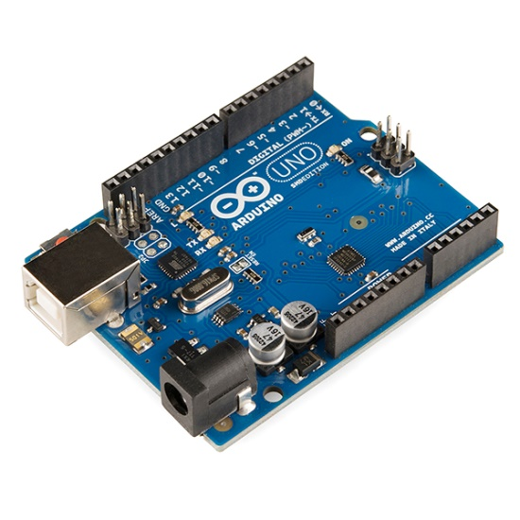
Hardware and Software –
1 . Arduino UNO- The Arduino Uno is an Open source microcontroller board based on the Microchip ATmega328P microcontroller. The board is equipped with sets of digital and analog (I/O) pins that may be interfaced to various expansion boards (shields) and other circuits. The board has 14 digital I/O pins (six capable of PWM output), 6 analog I/O pins, and is programmable with the Arduino IDE (Integrated Development Environment), via a type B USB cable. It can be powered by the USB cable or by an external 9 volts, though it accepts voltages between 7 and 20 volts.
Life Health Band – Health Monitoring System For Elderly People.

Slide 9
Technical Specification –
Operating Voltage: 5 Volts
Input Voltage: 7 to 20 Volts
Digital I/O Pins: 14 (of which 6 can provide PWM output)
UART: 1
I2C: 1
SPPI: 1
Analog Input Pins: 6
DC Current per I/O Pin: 20 mA
DC Current for 3.3V Pin: 50 mA
Flash Memory: 32 KB of which 0.5 KB used by bootloader
SRAM: 2 KB
EEPROM: 1 KB
Clock Speed: 16 MHz
Length: 68.6 mm
Width: 53.4 mm
Weight: 25 g
Life Health Band – Health Monitoring System For Elderly People.

Slide 10
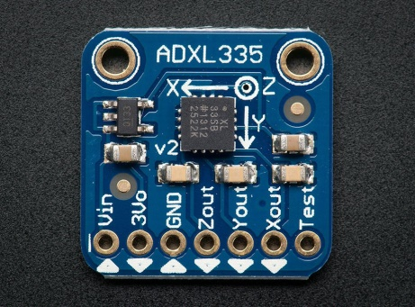
2. Accelerometer – An accelerometer is an electromechanical device that will measure acceleration forces. These forces may be static, like the constant force of gravity pulling at your feet, or they could be dynamic - caused by moving or vibrating the accelerometer.
By measuring the amount of static acceleration due to gravity, you can find out the angle the device is tilted at with respect to the earth. By sensing the amount of dynamic acceleration, you can analyze the way the device is moving.
Accelerometer will be used to locate the vip person on the z, y, and z axis parameters. The accelerometer will provide the location of the vip within the parliament location.
Technical specification –
3-axis sensing.
Small, low profile package.
4mm × 4 mm × 1.45 mm LFCSP.
Low power : 350 μA (typical)
Single-supply operation: 1.8 V to 3.6 V.
10,000 g shock survival.
Excellent temperature stability.
BW adjustment with a single capacitor per axis.
Life Health Band – Health Monitoring System For Elderly People.

Slide 11
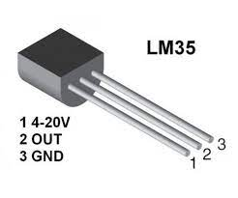
3 Temperature sensor: LM35 – Temperature sensor is used to sense the temperature. We have used a Temperature sensor called LM35. This temperature sensor can sense the temperature of the atmosphere around it or the temperature of any machine to which it is connected or even can give the temperature of the human body in case if used. So, irrespective of the application to which it is used, it gives the reading of the temperature. The LM35 series are precision integrated-circuit temperature sensors, whose output voltage is linearly proportional to the Celsius (Centigrade) temperature.
Temperature sensor is an analog sensor and gives the output into form of analog signal. This signal is feed to ADC which will convert it into digital form. Once converted into analog form, the microcontroller can process the digital temperature signal as per the application.
Technical Specification –
Calibrated Directly in Celsius (Centigrade)
Linear + 10-mV/°C Scale Factor
0.5°C Ensured Accuracy (at 25°C)
Rated for Full −55°C to 150°C Range
Life Health Band – Health Monitoring System For Elderly People.

Slide 12
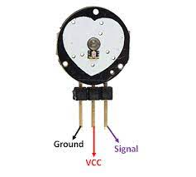
Suitable for Remote Applications
Low-Cost Due to Wafer-Level Trimming
Operates From 4 V to 30 V
Less Than 60-µA Current Drain
Low Self-Heating, 0.08°C in Still Air
Non-Linearity Only ±¼°C Typical
Low-Impedance Output, 0.1 Ω for 1-mA Load
4. Pulse Rate sensor – The Pulse sensor SEN-11574 is type of plug and play sensor most suitable for Arduino. The sensor is very easy to interface and install in any project and gives live Heart rate data. The Module is integrated with the optical amplifier and noise elimination ckt.
Technical Specification –
Biometric Pulse Rate or Heart Rate detecting sensor
Plug and Play type sensor
Operating Voltage: +5V or +3.3V
Current Consumption: 4mA
Inbuilt Amplification and Noise cancellation circuit.
Diameter: 0.625”
Thickness: 0.125” Thick
Life Health Band – Health Monitoring System For Elderly People.

Slide 13
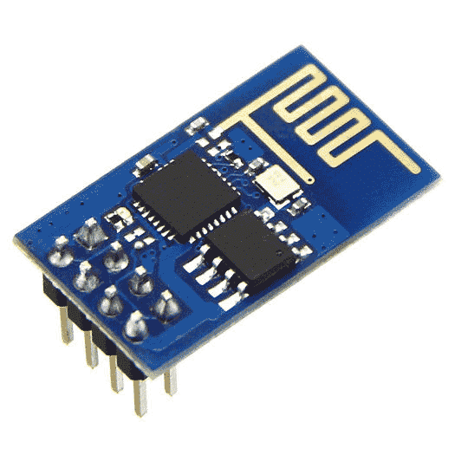
5. WiFi module for Arduino – The Arduino Uno WiFi is an Arduino Uno with an integrated WiFi module. The board is based on the ATmega328P with an ESP8266WiFi Module integrated. The ESP8266WiFi Module is a self contained SoC with integrated TCP/IP protocol stack that can give access to your WiFi network (or the device can act as an access point)
Technical Specification –
2.4 GHz Wi-Fi (802.11 b/g/n, supporting WPA/WPA2).
General-purpose input/output (16 GPIO).
Inter-Integrated Circuit (I²C) serial communication protocol.
Analog-to-digital conversion (10-bit ADC).
Serial Peripheral Interface (SPI) serial communication protocol.
I²S (Inter-IC Sound) interfaces with DMA(Direct Memory Access) (sharing pins with GPIO).
UART (on dedicated pins, plus a transmit-only UART can be enabled on GPIO2).
Pulse-width modulation.
Life Health Band – Health Monitoring System For Elderly People.

Slide 14
MQTT For IOT Based Application
MQTT stands for Message Queuing Telemetry Transport.
It’s a simple publish-and-subscribe system that allows you to send and receive messages as a client.
Publish
Subscribe
MQTT is a low-bandwidth messaging protocol optimized for limited applications. As a result, it’s ideal for Internet of Things applications.
You can use MQTT to monitor outputs, read and publish data from sensor nodes, and much more.
As a result, establishing contact between multiple devices is incredibly simple.
Life Health Band – Health Monitoring System For Elderly People.

Slide 15
MQTT- Broker :
The broker is in charge of collecting all messages, filtering them, determining who is
interested in them, and then broadcasting the message to all subscribers clients.
You can choose from a number of brokers. However, we will use the Mosquitto broker in
our system, For health band monitoring system.
DEVICE
DEVICE
DEVICE
BROKER
DEVICE
DEVICE
Publish
DEVICE
Subscribe

Slide 16
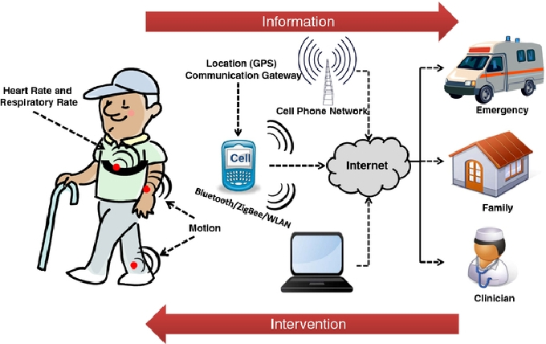
WORKING
Temp
Thursday
December 03,2020
Life Health Band – Health Monitoring System For
Elderly People.

Slide 17
We propose a portable and customizable IoT system that can be used to collect the data needed to facilitate the independent living of senior and challenged citizens to improve their quality of life.
The proposed system design philosophy targets are having a low-power system that can be worn during the day and be turbo charged as necessary.
The system is designed to be light and comfortable to wear. Furthermore, the system is implemented using low-cost components, which makes it an affordable system
In addition to the above medical sensor that capture the user’s health signs, light and fall detection sensors are also used.
The fall detection sensor is an accelerometer that is used to determine whether the user has fallen abruptly, Temperature changes, continuous pulse rate counting and changes in pulse rate such that warnings signals can be generated to provide the needed help.
Thursday
December 03,2020
Life Health Band – Health Monitoring System For
Elderly People.

Slide 18
controller is responsible for collecting the data of the different sensors interfaced to it, and communicating such a data to the server for further processing.
The Wi-Fi transceiver is used to connect the proposed system to the Internet.
The collected user’s data is communicated to a server which is responsible for facilitating the accessibility of such a data anywhere through the Internet.
The data can be accessed and manipulated through software tools.
This way the patient is continuously monitored by system ,and if there are some changes in expected readings occurs then warning will sent automatically to the users doctor, family as a feedback through IoT network.
Thursday
December 03, 2020
Life Health Band – Health Monitoring System For Elderly People.

Slide 19
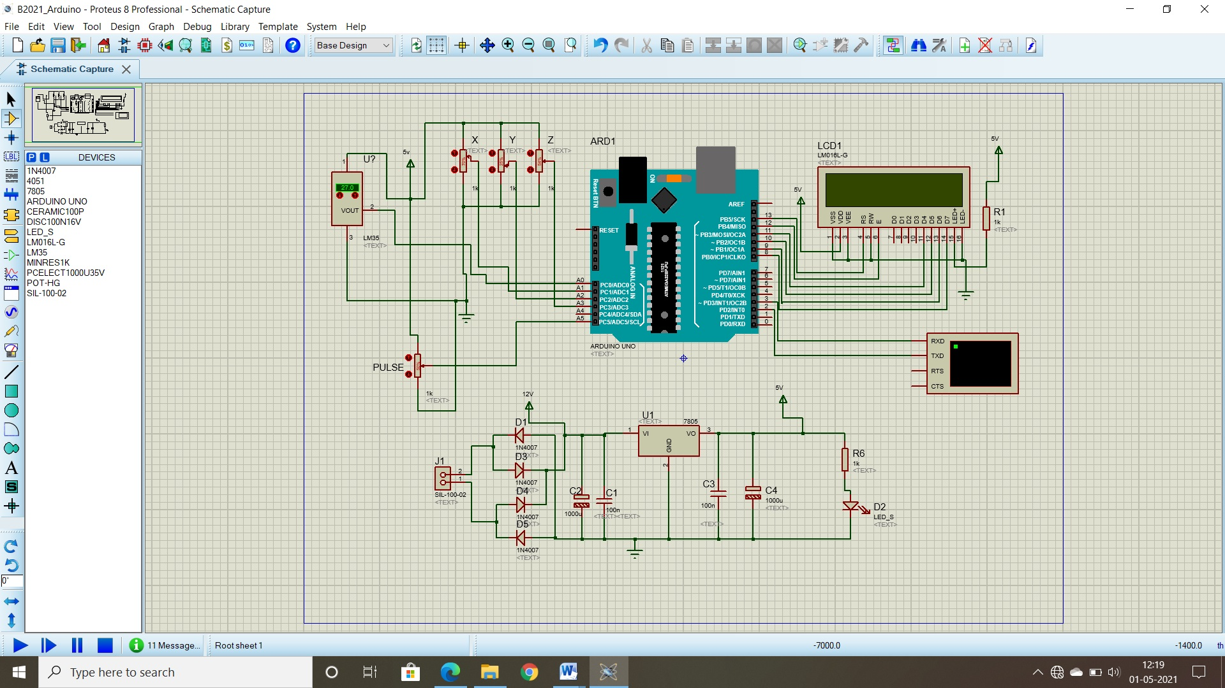
CIRCUIT DIAGRAM
Life Health Band – Health Monitoring System For Elderly People.

Slide 20
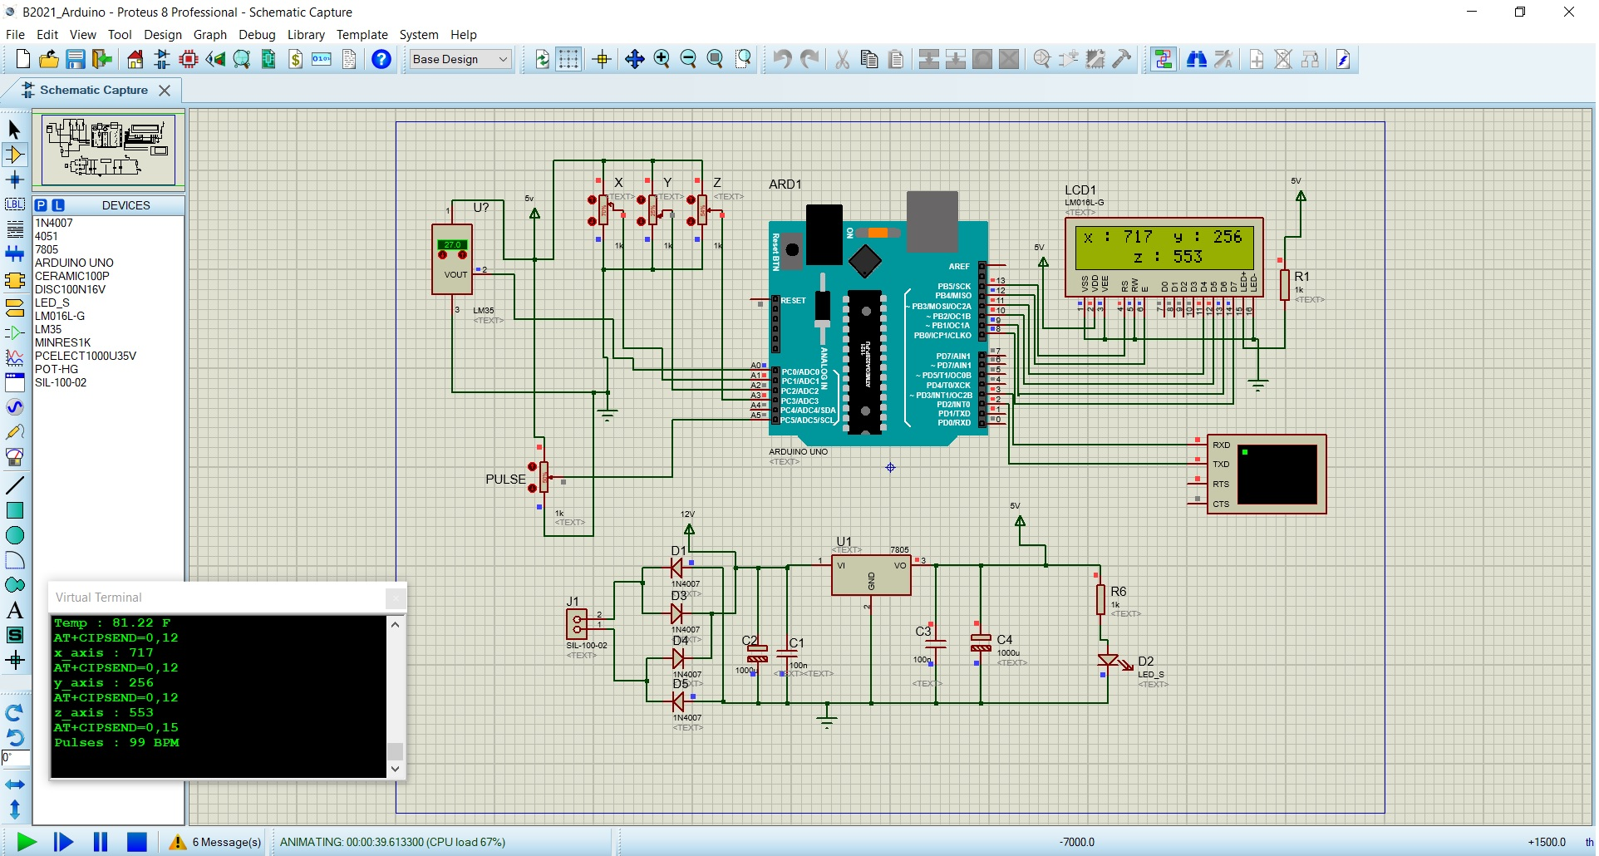
RESULTS
Life Health Band – Health Monitoring System For Elderly People.

Slide 21

Life Health Band – Health Monitoring System For Elderly People.

Slide 22
ADVANTAGES
Health Monitoring System provides real-time analysis of the patient’s health parameters.
Patients are sharing their healthcare information in real time with their caregivers through these devices for flexible health monitoring and management.
Internet of medical things is vastly improving the healthcare condition of patients.
It allows patients to maintain independence, prevent complications.
In addition, patients and their family members feel comfortable knowing that they are being monitored and will be supported if a problem arises.
Reduce burden for caretakers.
Improve confidence on their wellbeing.
Thursday
December 03,2020
Life Health Band – Health Monitoring System For
Elderly People.

Slide 23
APPLICATIONS
Monitor the motions and status of the person, heart beat rate, temperature, up-to-date.
A Sudden fall due to heart attacks or loosing balance, or abnormal fall or rise in heart beat rate it alters the nearby ones of the person to get immediate attention
The Health band also measures the temperature of the person in order to understand the person health condition.
Thursday
December 03,2020
Life Health Band – Health Monitoring System For Elderly People.

Slide 24
FUTURE SCOPE
We can add GPS Module in Patient Monitoring Using Arduino and Wi-Fi Module. This GPS Module will find out the Position or Location of patient using Longitude and Latitude received. Then it will send the location using Wi-Fi module so doctors , relatives can find the position of patient.
Future work may include how to secure the access of the data and will develop a mobile application that allows access of the data on handheld devices.
Thursday
December 03,2020
Life Health Band – Health Monitoring System For Elderly People

Slide 25
CONCLUSION
In this Project, we have presented a low-power wearable IoT system for active and assisted living healthcare applications. We have outlined the main components of the proposed system and explained their implementation details.
The preliminary performance evaluation results have demonstrated the efficiency of the proposed system despite being a low-cost one. This makes the proposed system a good candidate for implementing a wide set of wearable healthcare systems.
Thursday
December 03,2020
Life Health Band – Health Monitoring System For Elderly People.

Slide 26
REFERENCES
1.D. Kajaree and R. . Behera, “A Survey on Healthcare Monitoring System Using Body Sensor Network,” Int. J. Innov. Res. Comput. Commun. Eng., vol. 5, no. 2, pp. 1302–1309, 2017.
R. S. Pramila, “A Survey on Effective in-Home Health Monitoring System,” Int. J. Comput. Appl., vol. 68, no. 7, pp. 15–19, 2013.
R. S. Pramila, “A Survey on Effective in-Home Health Monitoring System,” Int. J. Comput. Appl., vol. 68, no. 7, pp. 15–19, 2013.
www.projecthub.com
Celal Bayar University Journal of Science Volume 14, Issue 3, 2018
ieeexplore.ieee.org
www.ijstr.org
www.ncbi.nlm.nlh.gov
Kakria, P., Tripathi, N. K., Kitipawang, P., A real-time health monitoring system for remote cardiac patients using smartphone and wearable sensors, International journal of telemedicine and applications, 2015
Remote Cardiac Patients Using Smartphone and Wearable Sensors. Int J Telemed Appl.
Thursday
December 03,2020
Life Health Band – Health Monitoring System For Elderly People.

Slide 27
THANK YOU…!

